Slide 1
Food Production and Consumption Patterns in Namibia
Tasks 3-8
Secondary analysis of NHIES 2015/16 data to support the design and implementation of national food and nutrition policies
18 December 2020

Slide 2
Overview
Task 3: g/c/d
Task 4: ADePT
Task 5: SADC calculations on micronutrient contribution of fortified foods
Task 6: DHS salt data
Task 7: Direct/discretionary salt intake from DRB
Task 8: Contribution of processed foods to salt intake

Slide 3
Task 3
From most appropriate sources, calculate consumption/availability of fortifiable (imported and commercially produced) wheat, maize and mahangu, vegetable oil, and milk as average g/capita/day nationally, for development of national fortification standards. Where available, compile data on regional consumption/availability of these foods, to illustrate regional variations in consumption/availability.

Slide 4
Task 3: Methodology
Data Sources: FAO ADePT results file (November 2020 version)
Software: Python 3.8
Analysis Process: The 2020 ADePT results for Namibia, calculated by FAO, were used to estimate the g/c/d at the national and regional level for several potential fortification vectors (food items), including wheat, maize, mahangu, salt, milk, oil and sugar including foods made with those foods. The estimated “fortifiable content” (i.e. % of the food made up of the fortified food - proportion of bread that is wheat flour) in each food item was provided by IGN. These proportions were applied to the individual food items in the ADePT results and summed to produce the output.
Limitations: The accuracy of the analysis is dependent upon the accuracy of the underlying ADePT results. Small adjustments in the “fortifiable content” proportions could have material impacts on the outputs.

Slide 5
Task 3: Foods included in the calculation and % fortifiable content for wheat flour
Food Item Code | Food item | Average quantity as purchased (g/c/d) | Cereal flour content (%)¹
01112.01 | Bread (white, brown, whole wheat, rye, maize, etc.) | 166.67 | 75
01112.02 | Brotchen | 0.41 | 75
01112.03 | Biscuits, rusks | 0.66 | 85
01112.04 | Vetkoek | 3.61 | 75
01113.01 | Macaroni, spaghetti, noodles | 14.55 | 45
01114.01 | Cakes (all types) | 1.44 | 65
01114.02 | Pies & pizzas | 0.28 | 70
01115.03 | Bread/ cake flour (all types) | 2.25 | 100
¹ Proportions provided by Jurgen Hanke, NamibMills, email 9 November 2020

Slide 6
Task 3: Foods included in the calculation and % fortifiable content for salt
¹ Proportions obtained from sodium content in South African Food Composition Tables x 2.5 to convert to salt
Food Item Code | Food item | Average quantity as purchased (g/c/d) | Salt content (per %)¹
01112.01 | Bread (white, brown, whole wheat, rye, maize, etc.) | 166.67 | 1.6
01112.02 | Brotchen | 0.41 | 1.6
01112.03 | Biscuits, rusks | 0.66 | 0.3
01112.04 | Vetkoek | 3.61 | 0.07
01113.01 | Macaroni, spaghetti, noodles | 14.55 | 00
01114.01 | Cakes (all types) | 1.44 | 1.05
01114.02 | Pies & pizzas | 0.28 | 0.96
01125.01 | Bacon | 0.27 | 3.99
01125.02 | Ham | 0.12 | 3.30
01125.03 | Biltong | 0.24 | 5.53
01125.04 | Smoked meat, other than bacon & ham | 0.41 | 2.4
Food Item Code | Food item | Average quantity as purchased (g/c/d) | Salt content (per %)¹
01125.05 | Polony | 1.13 | 2.55
01125.06 | Sausages, other than polony | 3.63 | 3.24
01126.02 | Canned meat | 0.99 | 2.5
01133.01 | Smoked fish | 0.12 | 1.7
01133.03 | Dried fish | 2.64 | 13.9
01134.01 | Bottled/ Tinned fish | 2.83 | 0.7
01145.01 | Cheese, all types | 0.87 | 2
01178.02 | Chips & crisps | 2.2 | 2.5
01191.02 | Tomato Sauces | 0.53 | 1.46
01192.02 | Spices & condiments | 0.19 | 30
01193.06 | Ready-made soup | 0.17 | 0.85
01193.07 | Powdered soup | 1.09 | 13.66

Slide 7
Task 3: Foods included in the calculation and % fortifiable content for maize, mahangu and milk
Food type | Food Item Code | Food item | Average quantity as purchased (g/c/d) | Cereal flour content (%)¹
Maize | 01112.09 | Traditional bread, ash bread, oshikwiila, oshima, omungome | 4.09 | 75
Maize | 01115.04 | Maize meal/ grain/ samp | 127.69 | 100
Mahangu | 01115.05 | Mahangu meal/ grain/ samp | 74.75 | 100
Mahangu | 01223.02 | Mageu/Oshikundu | 103.97 | 100
Milk | 01141.01 | Fresh milk | 10.98
Milk | 01141.02 | Long life milk | 0.67
Milk | 01142.01 | Fresh milk - Low fat | 0.02
Milk | 01142.02 | Long life - Low fat | 0.04
Milk | 01144.01 | Clotted/ Cultured milk | 3.36
¹ Proprortions provided by Jurgen Hanke, NamibMills, email 9 November 2020

Slide 8
Task 3: Key Findings/Results
 | Wheat_gcd_sum | Maize_gcd_sum | Mahangu_gcd_sum | Salt_gcd_sum | Salt_gcd_direct only¹ | Milk_gcd_sum | Oil_gcd_sum | Sugar_gcd_sum
!Karas | 227.37 | 147.89 | 30.48 |  | 7.49 | 29.7 | 5.33 | 12.6
Erongo | 292.32 | 75.20 | 42.75 |  | 5.53 | 23.06 | 7.43 | 10.29
Hardap | 253.21 | 84.47 | 4.36 |  | 6.39 | 32.7 | 4.01 | 18.29
Kavango East | 58.31 | 179.28 | 92.38 |  | 2.79 | 6.88 | 5.45 | 3.48
Kavango West | 30.28 | 220.54 | 361.81 |  | 3.04 | 4.72 | 4.43 | 2.6
Khomas | 208.67 | 67.09 | 46.24 |  | 6.58 | 22.25 | 5.85 | 6.92
Kunene | 76.10 | 263.98 | 16.21 |  | 7.13 | 16.18 | 6.65 | 14.24
Ohangwena | 57.31 | 145.20 | 306.19 |  | 4.37 | 4.28 | 9.14 | 5.67
Omaheke | 112.90 | 124.59 | 11.88 |  | 5.92 | 17.94 | 4.32 | 22.42
Omusati | 88.06 | 126.54 | 357.04 |  | 4.68 | 5.13 | 7.41 | 5.36
Oshana | 153.10 | 73.81 | 353.27 |  | 6.00 | 13.95 | 7.65 | 7.71
Oshikoto | 79.49 | 111.51 | 452.76 |  | 5.58 | 6.85 | 7.74 | 7.42
Otjozondjupa | 194.95 | 134.31 | 39.42 |  | 7.28 | 24.73 | 4.24 | 18.41
Zambezi | 59.73 | 337.88 | 13.50 |  | 4.60 | 20.46 | 8.85 | 7.71
Total | 138.51 | 130.76 | 178.72 | 9.0 | 5.4 | 15.07 | 6.66 | 8.82
¹ See Task 7 for explaination of methodolgy to estimate consumption of household salt (direct/discretionary consumption)

Slide 9
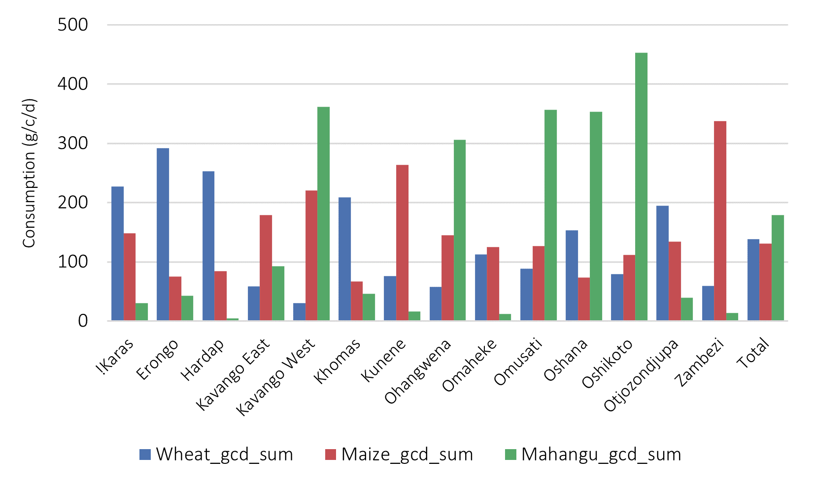
Task 3: Key Findings/Results
Overall consumption (g/c/d) of the main cereals (maize, mahangu and wheat) was roughly consistent with the general production and consumption patterns observed from the DRB for Tasks 1 and 2.

Slide 10
Task 4
Coordinate the integration of micronutrient values to enable FAO ADePT team to analyze micronutrient intake with breakdown by national, urban/rural, regions, ethno-linguistic group. This will involve reviewing the food matching, applying the most appropriate FCT for each food …

Slide 11
Task 4: Methodology
Data Sources: FAO ADePT matching file; West Africa FCT; Kenya FCT; USDA FCT; South Africa FCT
Software: Python 3.8
Analysis Process: The 2019 FAO ADePT food matching file for NHIES was updated through an iterative process to ensure optimal results. Using the FCT name and FCT codes in the matching file, micronutrient data from the corresponding FCTs was imported and matched. The resulting file was comprehensively verified and cleaned. Since the SA FCT was available only in pdf format, a separate extraction script was developed to facilitate the programmatic access/incorporation of this data. An updated matching file was prepared and shared with FAO who subsequently performed a new, clean ADePT analysis.
Limitations: The food item matchings (i.e. between NHIES and FCTs) can also be further refined. Incorrect matchings (e.g., a cooked food with an uncooked food; an unfortified food with a fortified food) can have material impacts on the overall results.

Slide 12
Task 4: Key Findings/Results
The Namibian diet is providing adequte micronutrients on average, with the exception of calcium
 | Vitamin B1, ratio consumed to required (%) | Vitamin B2, ratio consumed to required (%) | Vitamin B6, ratio consumed to required (%) | Vitamin B12, ratio consumed to required (%) | Folate, average consumption (mcg/capita/day) | Vitamin C, ratio consumed to required (%) | Calcium, ratio consumed to required (%) | Iron, average consumption from animal sources (mg/capita/day) | Iron, average consumption from non-animal sources (mg/capita/day) | Zinc, ratio consumed to required for an unrefined diet (%) | Zinc, ratio consumed to required for a refined diet (%)
Total | 371 | 197 | 705 | 233 | 649.02 | 110.43 | 30.31 | 33.28 | 33.28 | 246 | 333
Quintiles of income
Lowest quintile | 282 | 143 | 418 | 132 | 548.36 | 54.69 | 20.22 | 23.08 | 23.08 | 182 | 244
2 | 367 | 197 | 658 | 186 | 615.84 | 80.55 | 26.90 | 36.01 | 36.01 | 252 | 339
3 | 404 | 210 | 810 | 253 | 688.19 | 128.35 | 32.48 | 37.03 | 37.03 | 266 | 362
4 | 431 | 224 | 906 | 294 | 722.78 | 153.48 | 36.65 | 38.52 | 38.52 | 281 | 382
Highest quintile | 462 | 269 | 1052 | 453 | 818.19 | 219.62 | 52.11 | 41.37 | 41.37 | 300 | 411
urban/rural (2 categories)
Urban | 353 | 181 | 829 | 292 | 634.13 | 146.57 | 32.11 | 28.48 | 28.48 | 230 | 312
Rural | 386 | 211 | 596 | 181 | 661.85 | 78.38 | 28.83 | 37.41 | 37.41 | 261 | 353

Slide 13
Task 4: Key Findings/Results
The majority of vitamins A, B1, B2, B6, zinc, folate and iron is being provided by cereals and tubers, most likely wheat flour/bread and maize meal – see next slide

Slide 14
Task 4: Key Findings/Results
Bread and maize meal are contributing significantly to vitamin A, B1, B2, calcium, zinc, folate and iron intake

Slide 15
Task 4: Key Findings/Results
The full FAO ADEPT excel file can be found HERE

Slide 16
Task 5
Review SADC calculations, which used the A2Z Food Formulator, on estimated nutrient contribution of fortified foods to ensure calculations were correctly done.

Slide 17
Task 5: Methodology
Data Sources: Estimate of contribution of fortified foods to micronutrient intake prepared by SADC consultant
Software: Excel
Analysis Process: In order to confirm SADC consultant’s calculation process, A2Z formulator for different food items were reviewed to understand the underlying methodology. Values for Namibia were then plugged in to determine if SADC results could be replicated.
Limitations: SADC consultant did not document well the inputs or assumptions used in calculations.

Slide 18
Task 5: Key Findings/Results
Notwithstanding the limitations, was able to (generally) confirm that, at the very least, the approach used by the SADC consultant agreed with that required by the A2Z formulator.
 |  | Vit A EAR | Vit A, UTL% | Folic Acid EAR% | Folic Acid UTL% | Iron EAR | Iron UTL% | Zinc EAR | Zinc UTL% | B12 EAR | B12 UTL% | IODINE EAR | IODINE UTL%
Sugar, 10mg/kg | Women | 88 | 28
Pe Capita: 54 | Men | 84 | 20
 | Children | 54 | 40
Oil, 25mg/kg | Women | 64 | 23
Pe Capita: 18 | Men | 68 | 29
 | Children | 40 | 45
Wheat Flour, 10mg/kg | Women | 25 | 6 | 44 | 17 | 16 | 19 | 53 | 19 | 33 | N/A
Pe Capita: 99 | Men | 27 | 8 | 56 | 21 | 26 | 24 | 47 | 24 | 42 | N/A
 | Children | 17 | 12 | 54 | 25 | 50 | 13 | 32 | 13 | 40 | N/A
Maize Flour, 10mg/kg | Women | 31 | 7 | 54 | 20 | 21 | 24 | 46 | 17 | 40 | N/A
Pe Capita: 119 | Men | 32 | 9 | 68 | 25 | 35 | 25 | 41 | 21 | 51 | N/A
 | Children | 20 | 15 | 64 | 30 | 65 | 47 | 28 | 37 | 48 | N/A
Salt, 30mg/kg | Women |  |  |  |  |  |  |  |  |  |  | 167 | 32
Pe Capita: 7 | Men |  |  |  |  |  |  |  |  |  |  | 143 | 26
 | Children |  |  |  |  |  |  |  |  |  |  | 119 | 60

Slide 19
Task 6
Analyze raw data from Namibia DHS as follows:
DHS 2000 to identify proportion of households per region with (i) “block salt” and (ii) salt from salt pans
DHS 2006/7 to see if household coverage of iodized salt is available
Comparison of household coverage of iodized salt from 2000 and 2013 to see if there is a poor correlation between the two years.

Slide 20
Task 6: Methodology
Data Sources: 2000, 2006, 2013 Namibia DHS datasets
Software: Python 3.8
Analysis Process: HH files from each year were imported and reviewed based on the key objectives outlined.
Limitations: Salt data not available in 2006. Methods for testing salt for iodine in 2000 were different than in 2013 – the former tested ppm whilst the latter on check if present or not. This made comparison between the two years less robust.

Slide 21
Task 6: Key Findings/Results
A substantial proportion of households in Omusati and Oshana regions (17%) reported that the main source of their household salt was from a salt pan.

Slide 22
Task 6: Key Findings/Results
In some regions, such as Ohangwena, Omaheke and Oshikoto a substantial proportion of salt is described as “block salt”; this may not be salt coming from the major Namibian salt refineries

Slide 23
Task 6: Key Findings/Results
The iodine data from 2000 and 2013 by region were roughly similar but given the difference in testing methodology it is difficult to draw any strong conclusion from this.

Slide 24
Task 7
Review DRB data on household salt intake to address any data quality issues and generate a direct assessment of national and regional intake (g/c/d) of household salt (01192.01 Salt)

Slide 25
Task 7: Methodology
Data Sources: NHIES 2015/16 Daily Record Book Dataset file
Software: Python 3.8
Analysis Process: A subset of the DRB file was created containing all rows wherein the HH had consumed salt in the last 7 days. Estimated number of grams consumed was calculated by assuming different values for the units of measure (e.g., 1 teaspoon of salt was assumed to weigh 5.9 grams). These values were applied, and extreme outliers cleaned/removed by preparing a cumulative density distribution of the grams/cap/day consumed. The mean and medians of this truncated distribution were then calculated.
Limitations: The volume of data (e.g., salt dataset was 48,000+ rows) and available time prevented a more comprehensive cleaning approach. The CDF truncation approach was effective for obtaining a “best estimate” quickly. The ADePT cleaning methodology and algorithm is not well documented, making it challenging to understand key differences.

Slide 26
Task 7: Key Findings/Results
Region | Salt_mean | Salt_median
Total | 5.39 | 4.87
!Karas | 7.49 | 5.90
Erongo | 5.53 | 5.90
Hardap | 6.39 | 5.90
Kavango East | 2.79 | 2.41
Kavango West | 3.04 | 2.53
Khomas | 6.58 | 5.90
Kunene | 7.13 | 5.90
Ohangwena | 4.37 | 3.92
Omaheke | 5.92 | 5.90
Omusati | 4.68 | 3.90
Oshana | 6.00 | 5.69
Oshikoto | 5.58 | 5.39
Otjozondjupa | 7.28 | 5.90
Zambezi | 4.60 | 3.93
Based on the methodology outlined above, the estimated amount of salt consumed in Namibia was 5.38 g/c/d. This is substantially higher than the 1.26 g/c/d estimated by ADePT software.

Slide 27
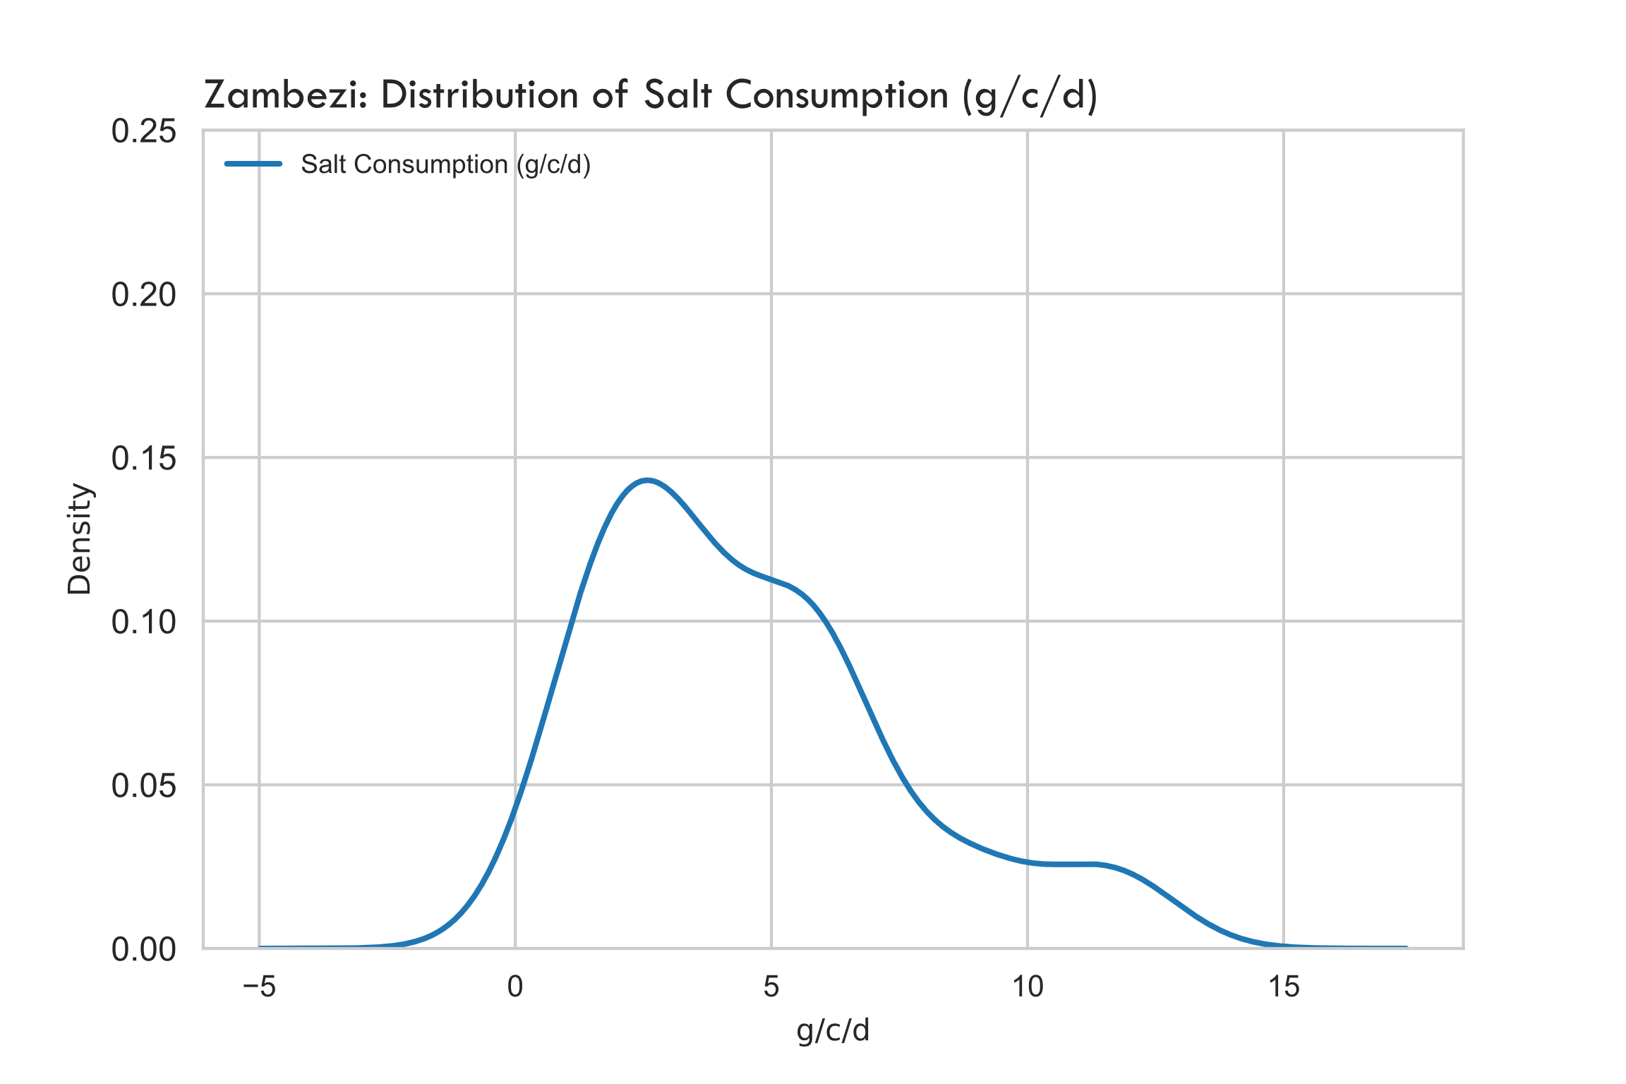
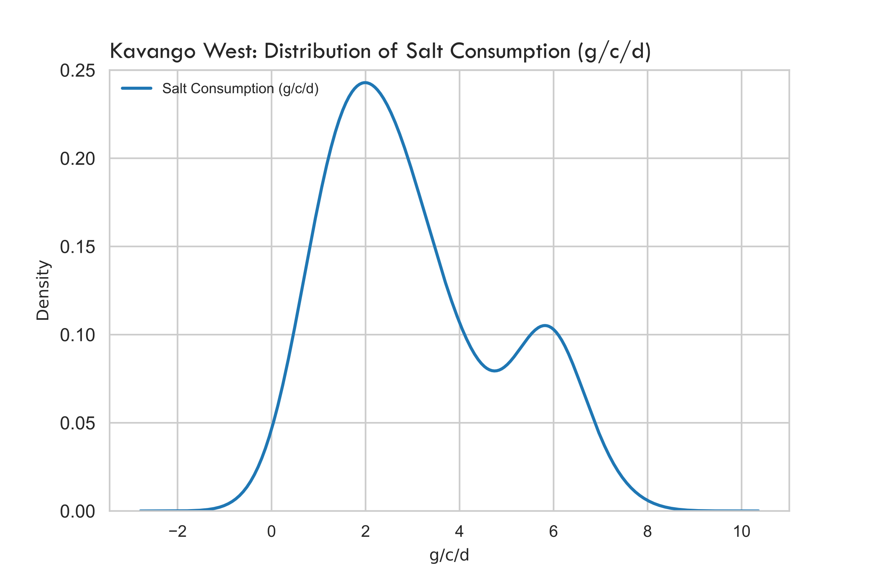
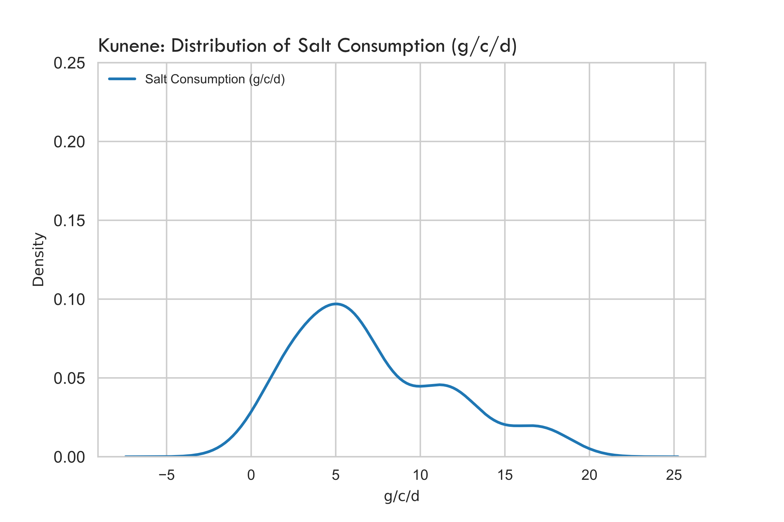
Task 7: Key Findings/Results
Apart from Kavango East and West, the distribution of salt consumption was very similar throughout the regions.

Slide 28
Task 8
Calculate the contribution of household salt (from point 7) and processed food to salt and iodine intake using the IGN Programme Guidance on the Use of Iodized Salt in Industrially Processed Foods.

Slide 29
Methodology
Used data from Outputs 3 (g/c/d of processed foods) and Output 7 (estimate of direct/discretionary salt intake from DRB to assess the contribution of HH salt and procesed foods to salt and iodine intake using the IGN Guidance on Use of Iodized Salt in Processed Foods.

Slide 30
Task 7: Key Findings/Results

